Slide 1
Telecom Churn Rate Case Study
X Education Company

Slide 2
Problem Statement
Identify high value customer and Churn rate.
Give recommendation to company for policy or strategy for retention of high value customers.

Slide 3
Data Collected
Given data has been collected which contains 226 features and 99999 rows.
There are few columns which are not important for the analysis and most of other features are continuous and null columns and few are categorical.

Slide 4
Reduce complexity of variability
As the dimensionality if too high, we need to reduce columns which are less important like
Drop Individual features whose total are available as a different attributes.
Convert features which are 2 value to an ordered categorical feature and convert it into integer.
Keeping only high value customers.
Remove 9th month values
Drop columns where variance is 0

Slide 5
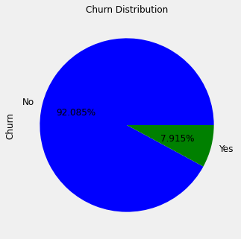
Imbalance Data
Data set is very imbalanced and need different solutions for the same like SMOTE.

Slide 6
Model Creation
Apply multiple models and finalize Logistics regression which is simple and give good results.
Accuracy Score : 0.8612
Precision Score : 0.3412
Recall Score : 0.8276
F1 Score : 0.4832
Area under curve : 0.8458

Slide 7
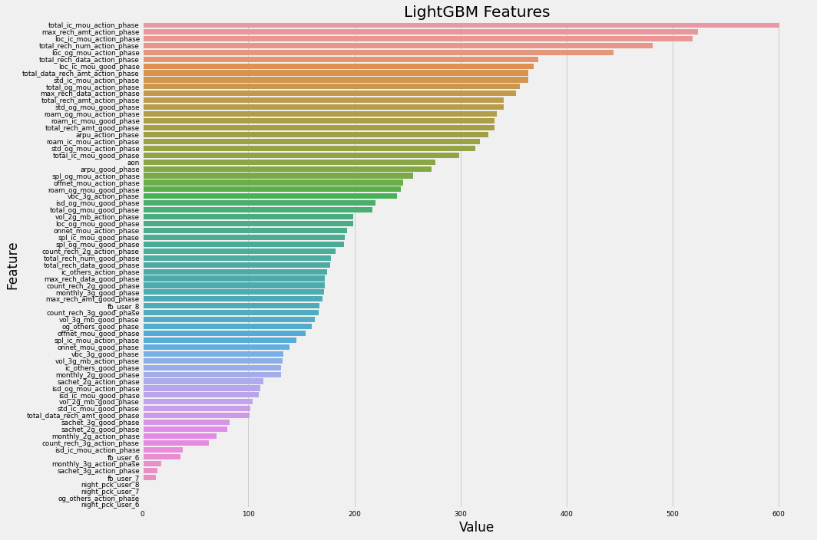
Top Features
Top 20 features , 14 out of 20 features are from action phase, where as rest 6 features are from good phase.
Incoming Calls
Total Recharge Number
Outgoing Calls
Roaming
Total Amount Recharge

Slide 8
Accuracy Matrix
Accuracy Score is 85.46% using statsModel
Accuracy Score is 85.89% using SKlearn
Sensitivity / specificity
0.8009132420091324 / 0.8896839594514013
Recall / precision
0.7830494728304948 / 0.8355690177412376
Confusion_matrix
[[1492, 185],
[ 218, 877]])

Slide 9
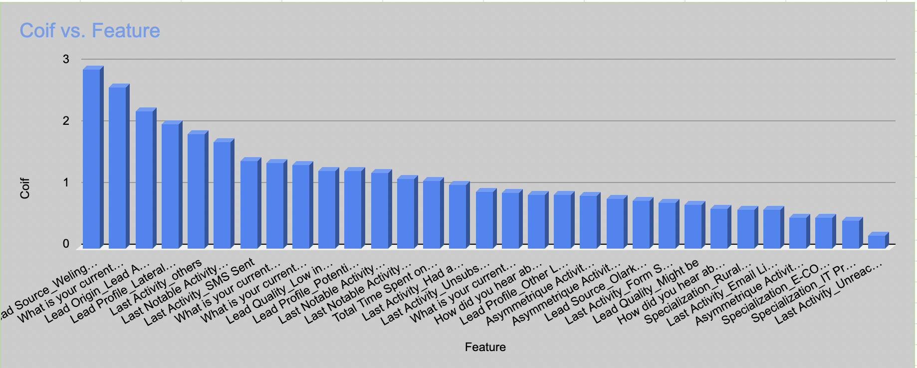
Top Features
Top 3 features are :
What is your current occupation_Working
Lead Origin
Lead Source
Features which are not contributing to conversion.
Newspaper Article
X Education Forums
Newspaper
Do Not Call

